Slide 1
Simulation of Wi-Fi based TSN Mechanisms using
NS-3 Simulator
WiFi 6 AX, FTM, TWT and QoS
Prof. Dr.-Ing. Axel Sikora
Manuel Schappacher
Jubin Sebastian Elayanithottathil
Aneemesh Vidyarthi

Slide 2
Contents
Background
Implementation
Composition
Architecture
Notes
Methodology
Points
Timeline
References

Slide 3
Background
ivESK works on Time Sensitive Networks (TSN) for industrial communications
TSN uses accurate time sync (802.1AS) and scheduling like Time Aware Shapers (802.1Qbv)
TSN is technology-agnostic but Wi-Fi has challenges like asymmetric paths, unreliable links
Wi-Fi has different protocols than Ethernet TSN e.g. Fine Time Measurement (FTM), Access Categories (AC)
Goal is to create ns-3 simulations to model Wi-Fi based TSN
Will integrate/modify existing ns-3 models like Wi-Fi, FTM, PTP, Qbv Ethernet
This will setup a simulation framework to evaluate parameters and behavior of TSN over Wi-Fi

Slide 4
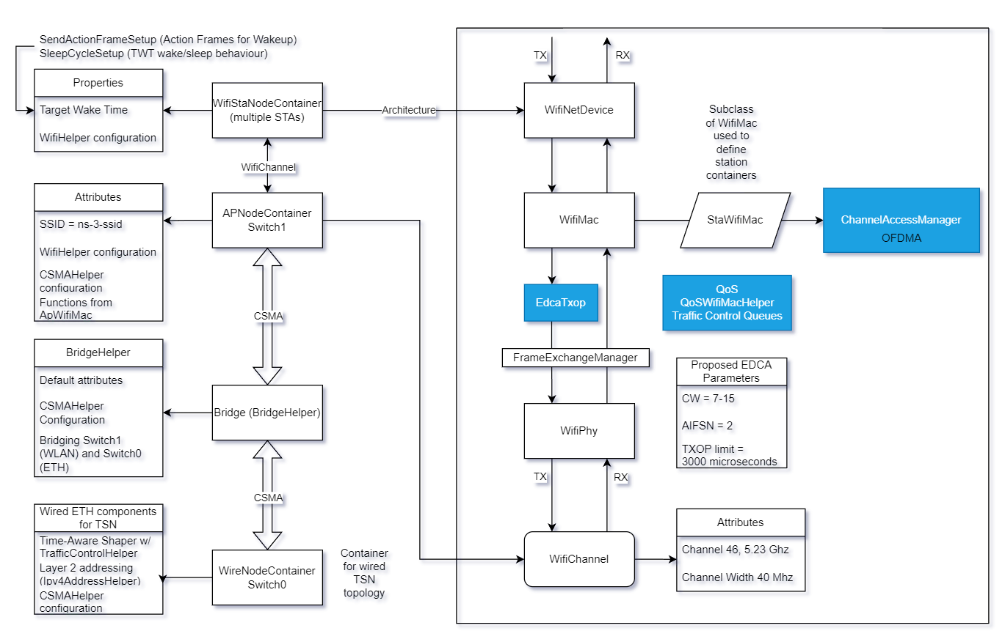
Implementation – Composition – Architecture

Slide 5
Implementation – Composition – Notes
1 broadcasting AP, several STA endpoints
Classified for real-time, best effort etc for different use cases per endpoint (QoS)
TSN switches connected to TSN WLAN region
Clocks per node. (GM is TSN switch)
TWT based sleep/wake for STAs (Wi-Fi 6 spec)
More APs for interference testing
FTM in place of gPTP for wireless time sync for STA and APs
Time-Aware Shaper
IEEE 802.1Qbv on wired TSN switch
We do not use Qbu and br, frame pre-emption not possible on Wi-Fi 6
Wi-Fi QoS implementation for minimizing interference
Best effort, video, voice, background ACs
Queue Discs to define priority levels for different ACs (derived from TAS)
We use BE (best effort) for defining realtime traffic

Slide 6
Implementation – Methodology – Points
TSN-enabled switch connected to Wi-Fi 6 enabled stations using FTM for time sync
Attempt to implement Wi-Fi QoS on stations and AP to mitigate latency with traffic classification
ns-3 QoS tagging and queues on the Wi-Fi net devices
ns3::EdcaTxop defines access classes (BE, Vi, Vo, Bg,)
QosWifiMacHelper attribute using smart pointer to WifiMac objects (AP and STA)
Traffic control queues mapped to different Wi-Fi AC priorities (QueueDiscContainer)
QoS tagging rules on all sockets to enable datagram flags
Contention Window – Backoff algorithm – Randomized time slot allocation
Time-Aware Shaper on wired TSN switch. (IEEE 802.1Qbv)
Isolated channel using OFDMA for multiple resource units on the same channel (optional)
Goals:
Deterministic Networking
Minimizing Jitter and Latency
Spectrum efficiency and isolation (optional)

Slide 7
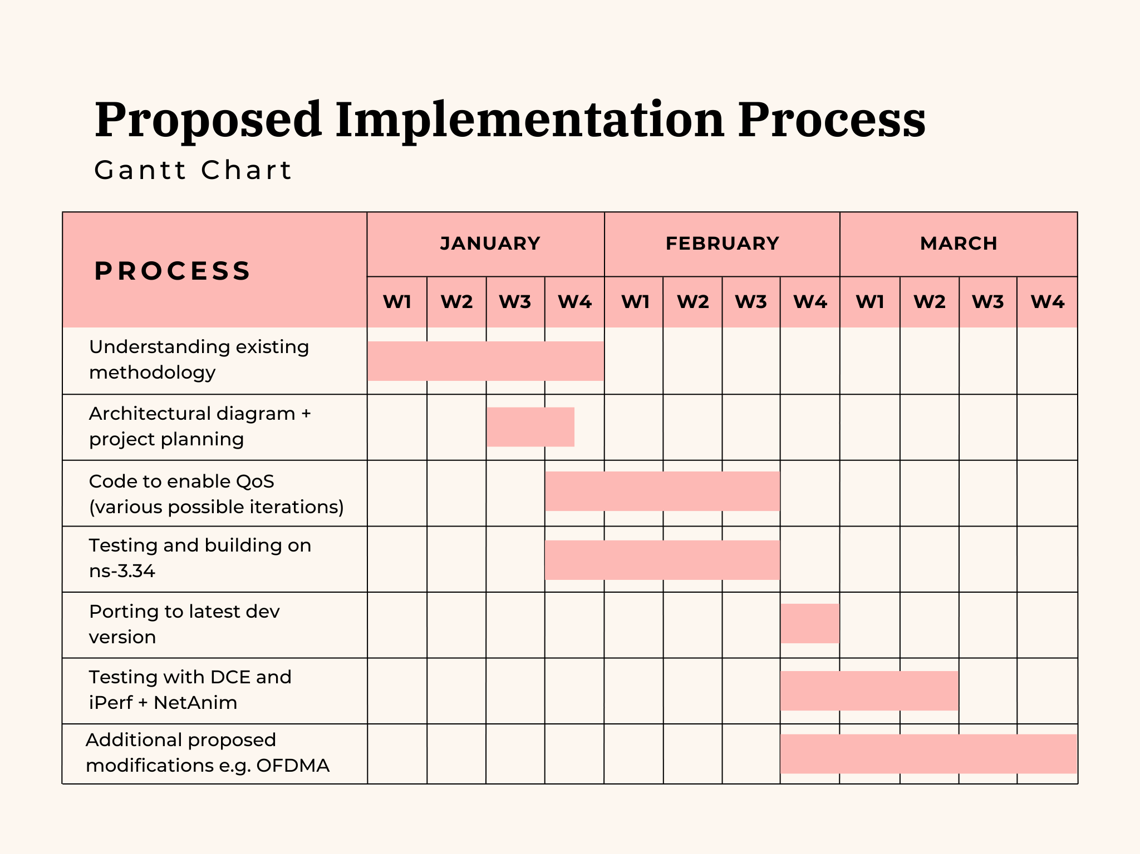
Implementation – Methodology – Timeline

Slide 8
References
https://www.nsnam.org/docs/
IEEE 1588 documentation for standards used
https://www.youtube.com/watch?v=K3H9L6FM-xo
https://www.researchgate.net/profile/Dennis-Krummacker/publication/348431501_TSN_Simulation_Time-Aware_Shaper_implemented_in_ns-3/links/5ffec2c0299bf140888ff7cd/TSN-Simulation-Time-Aware-Shaper-implemented-in-ns-3.pdf
https://groups.google.com/g/ns-3-users/c/idtjCwij-lE?pli=1
https://www.nsnam.org/docs/release/3.28/doxygen/classns3_1_1_edca_txop_n.html#details
https://www.nsnam.org/docs/release/3.24/doxygen/classns3_1_1_dca_txop.html

